Slide 1

Data Science 105
Machine Learning - Simple Models

Slide 2
Schedule
 | Title | Description | Exercise
1 | Python 101 | Intro to syntax and core concepts | Python workbook
2 | Data Analysis | Analysis libraries (numpy and pandas) | CO2 Analysis
3 | Databases | DB storage and SQL | Build own database
4 | Visualisation | Sexy graphs, charts, and wordclouds | Colourful visualisation
5 | Machine Learning | Simple models | Regression & Decision Trees?
6 | Machine Learning | Complex models | Visual recognition
7 | Watson Integration | Integrating with Watson cloud services | Watson labs

Slide 3
Outline
Intro
Different Types of ML
Practical:
Decision Trees
Linear Regression
Prep for next session: Visual Recognition

Slide 4
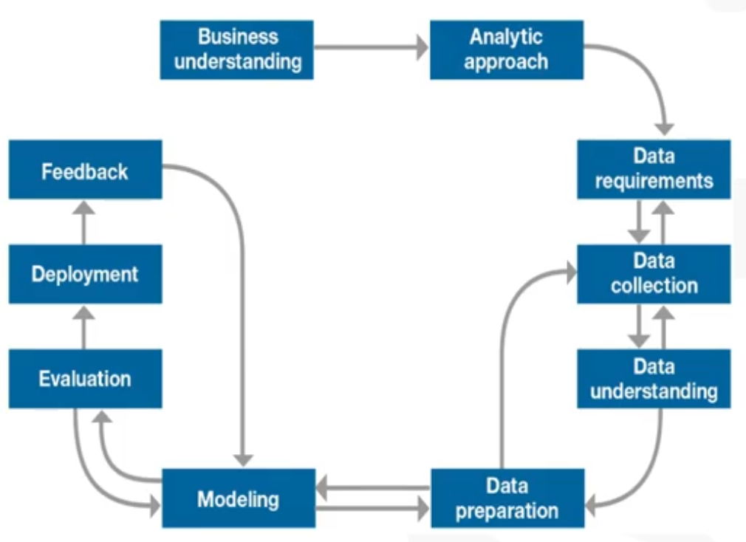
The latter stages of our DS Journey

Slide 5
Not a ML course
“Systems that can learn from data/experience to find patterns”
i.e. Teaching a computer to recognise patterns by example rather than giving it specific hard rules
Recommended Reading
Machine Learning in simple language
A Google Data Scientist’s accessible descriptions

Slide 6
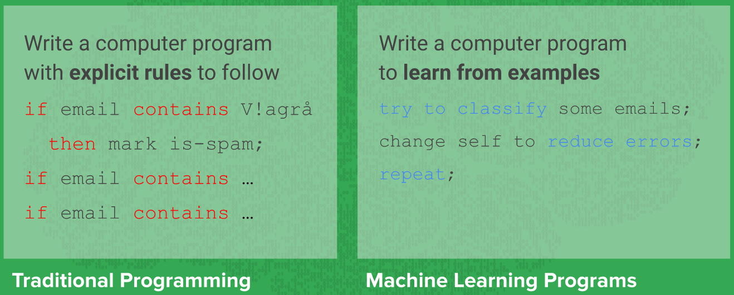
Learning by Example
Take some data
Learn patterns
Classify previously unseen data

Slide 7
Supervised Learning
Where the ML program is provided with training data that is labelled
You tell the system how to categorise the example data
Use labelled examples to predict future unseen inputs
Colour | Weight | Label
Red | 200g | Apple
Orange | 300g | Orange
Green | 175g | Apple

Slide 8
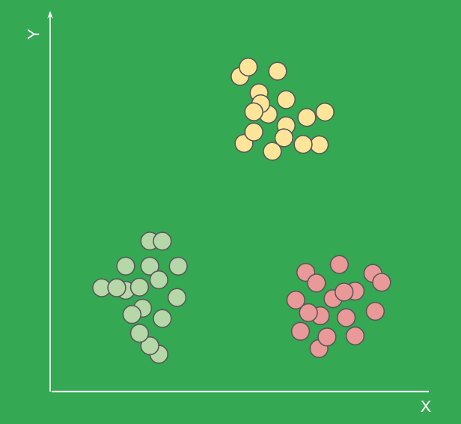
Unsupervised Learning
The machine must learn from an unlabelled data set
e.g. The machine sees there are distinct clusters in data, then categorises the data into given clusters
This is tricky as the number of clusters may not be known in advance
Not all clusters are so distinct. What if there are more than 2 dimensions?

Slide 9

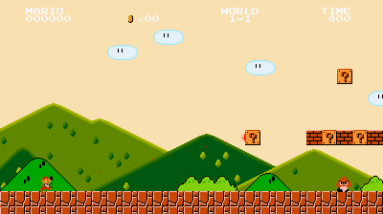
Reinforcement Learning
Learning from trial-and-error. Lots of it
Declare what ‘good’ and ‘bad’ outcomes are and let the program run something millions of times
Overtime, the model learns to maximise reward without explicit rules

Slide 10
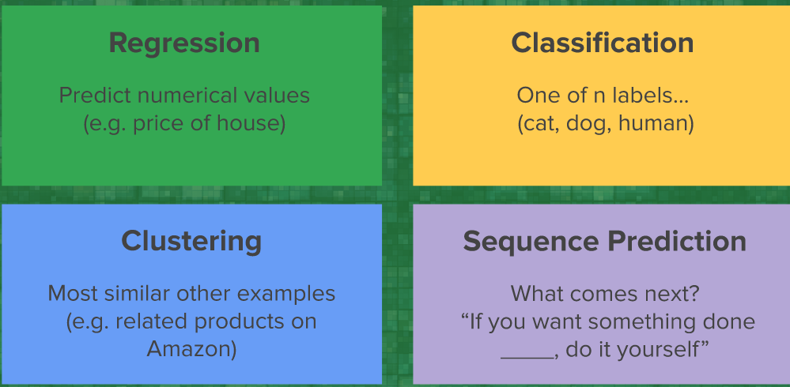
Common ML Output Types

Slide 11
Let’s get doing

